Slide 1

NLP Project 3: Automated Customer Reviews
Mon, 01.09.2025
Dr. John-Baptist Naah

Slide 2
TOC
Project Overview
Data Pre-processing/Cleaning
Exploratory Data Analysis (EDA)
Main Results & Evaluation
Project Management & Major Obstacle
App Demo & Deployment
Conclusion & Insights

Slide 3
Project Overview
Business case: This project is about automating the review process for various Amazon products using NLP models to extract insights and provide users with valuable product recommendations.
Problem statement: Thousands of reviews of Amazon products by users across the global cannot be manually checked, as it is laborious and ineffective to do so
Project goal: To develop a product review system powered by NLP models that aggregate customer feedback from different sources
Key tasks: The main tasks of this project are 1) classifying reviews, 2) clustering product categories, and 3) summarizing reviews into recommendation articles using NLP models

Slide 4
Project Timeline
Day1 - Tue
Day2 - Wed
Day3 -Thu
Day4 -Fri
Planning Phase
Implementation
Implementation
Final delivery day
•Decisions on dataset
• Adopt system-thinking approach
• Clarifying questions
• Set up my Notebook for coding
•Data Pre-processing
• Model fine tuning
• Model fine tuning
• Analysis & results
• Prepare requisite Files for upload
• Finalise coding
• Finalise PPT presentation
• Final submission via Github

Slide 5
Data Pre-processing/Cleaning
01
Primary Dataset: The Kaggle dataset consisting of 3 separate csv files were merged for data pre-processing
02
Libraries: Necessary dependencies are installed/imported
03
Coding: Notebook for building, training/fine-tuning and deployment of my model

Slide 6
Data Pre-processing/Cleaning
01
Sentiments-related data: 1) Missing values were addressed by dropping any rows with null entries to ensure a clean dataset for subsequent analysis, 2)Handling Imbalanced Data with SMOTE (Synthetic Minority Over-sampling Technique)
02
Clustering-related data: 1) I converted the text reviews into meaningful numerical vectors(embeddings), 2) I used an algorithm to group similar reviews based on these embeddings, creating distinct clusters, 3) I used a technique called t-SNE to reduce the dimensions of these clusters to 2D for easy visualization
03
Summarization-related data: 1) I applied Prompt Engineering for models like T5 and OpenAI, 2) I performed a zero-shot summarization task, meaning we could get an accurate summary without training the model on specific review data

Slide 7
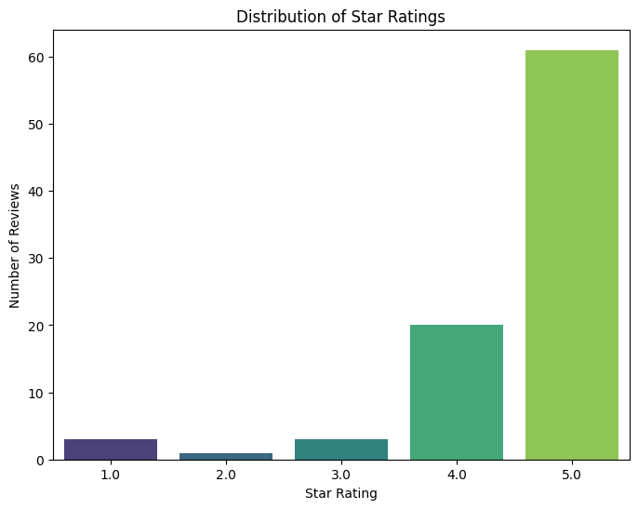
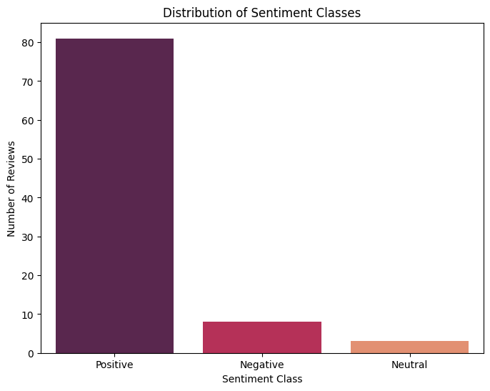
Exploratory Data Analysis (EDA)

Slide 8
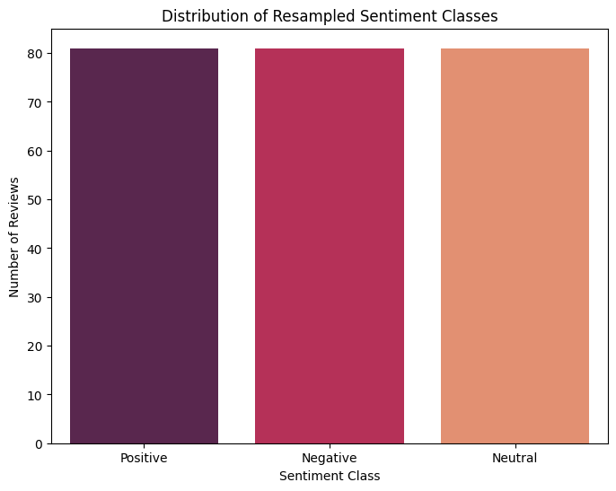
Exploratory Data Analysis (EDA)
SMOTE (Synthetic Minority Over-sampling Technique) output after handling imbalanced data.

Slide 9

Main Results & Evaluation
 | Pre-trained Models
Metric | Bert-base-uncased | Distilbert-base-uncase | Roberta-base
Accuracy | 88 | 94 | 86
F1 | 88 | 94 | 86
Precision | 88 | 95 | 86
Recall | 88 | 94 | 86
Fine Tuning-Sentiment Model
This is how well the sentiment dataset worked with the 3 pre-trained Models during fine-tuning process
88%
94%
86%
Accuracy
Bert-base-uncased
Accuracy
Distilbert-base-uncased
Accuracy
Roberta-base

Slide 10
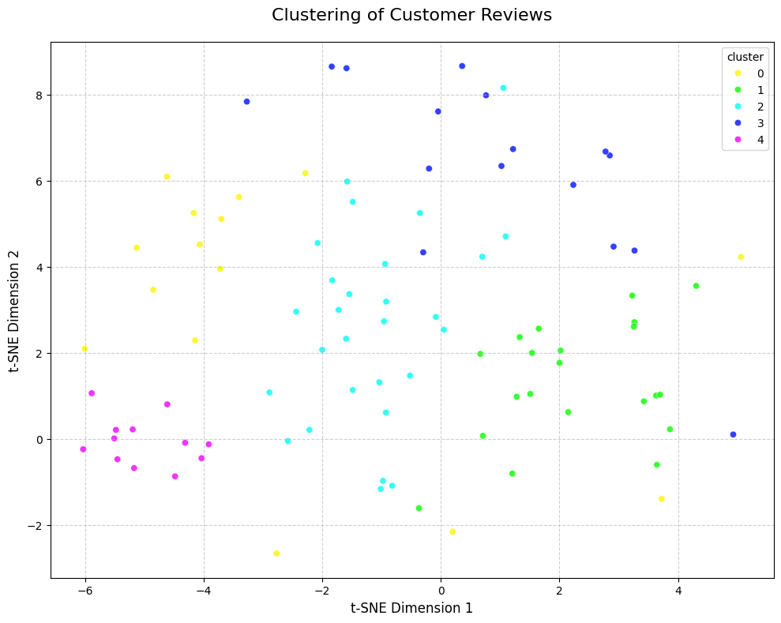
Main Results & Evaluation
Clustering results

Slide 11
Main Results & Evaluation
Summarization results-AI-Powered Summarization
Powered by models like OpenAI's GPT and Google's T5 to turn detailed reviews into a brief, professional summary.
Original review: ‘I loved this at first, but the battery stopped holding a charge after about 6 weeks. It's now completely unusable. I'm very disappointed with the poor quality.’ + 2 other negative reviews.
AI-Generated Summary: ‘Customers are consistently reporting that the product has poor durability and is prone to breaking or failing within a few weeks of use, citing low-quality materials and poor battery life as key issues.’

Slide 12
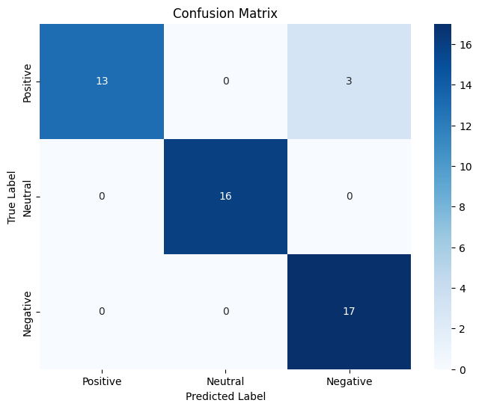
Main Results & Evaluation
• Confusion Matrix: visualizing the Sentiment Model's performance.
• The Matrix showing which sentiment classes the model is confusing.

Slide 13
Project Management & Major Obstacles
Merged Dataset challenge: Getting errors often due to possible new columns from the merged dataset
Google Colab Crash: During fine-tuning of the Sentiment Model with Roberta-based uncase, the process crashed leading to re-running and wiping of initial results from Colab
Wrong approach: In dealing with the imbalanced primary dataset for building, fine-tuning and evaluating the sentiment Model from the beginning
Project management: Resolved these regular challenges and got a a robust fine-tuned Sentiment Model in the end!

Slide 14

App Demo & Deployment
Summary of the App
The web app is designed to handle users reviews of Amazon products and output automated sentiments expressed by various users in 3 different components i.e. classification, clustering, and text summarizer.
I call this App ‘Product Review AI Assistant’
App is locally deployed for now
Expecting to launch it on Hugging Face Spaces

Slide 15
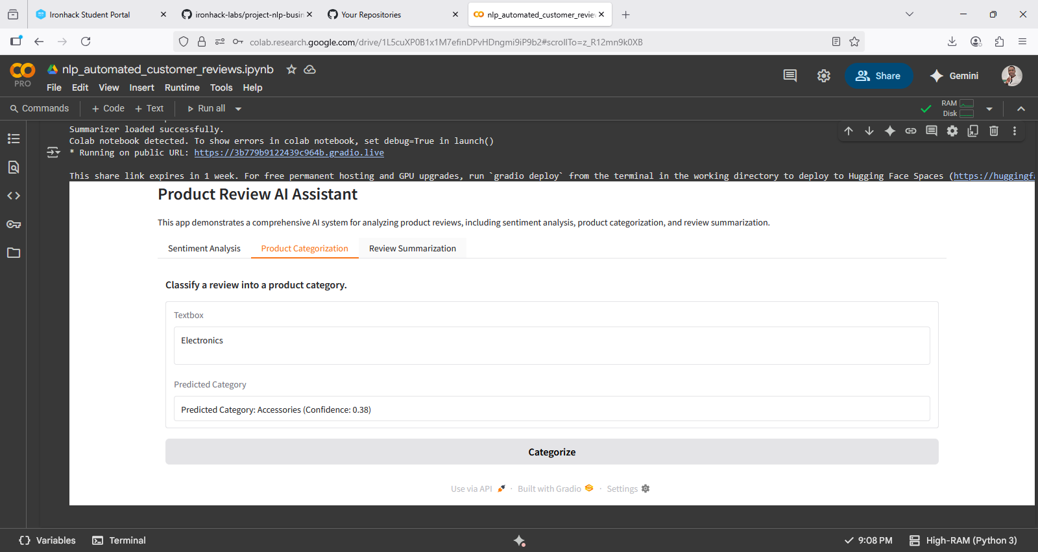
App Demo & Deployment
App Link & Screenshot of the App for Demo purposes
App URL: https://44f31625f91f3fabc3.gradio.live

Slide 16


Conclusion & Insights
The business case on automated customers reviews was a great Project to work
Gaining skills in building and fine-tuning sentiment Model to automatically check reviews from customers
Practical App building and deployment
More room for improvement, i.e. coding skills

Slide 17


Thank you! Dankeschön! Merci! ...

